Slide 1
Addressing Community Concerns

Slide 2
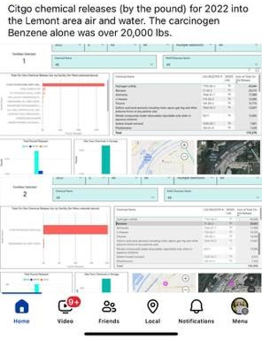
December 2024
Concern:
CITGO Lemont chemical releases for benzene were 20,000 lbs in 2020.
In fact…
In fact, the reported number was the result of a data entry error. The actual benzene reported was half of this value and has been corrected in the federal database.
.

Slide 3
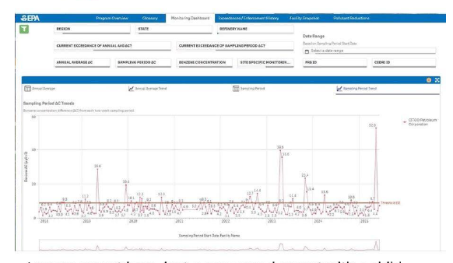
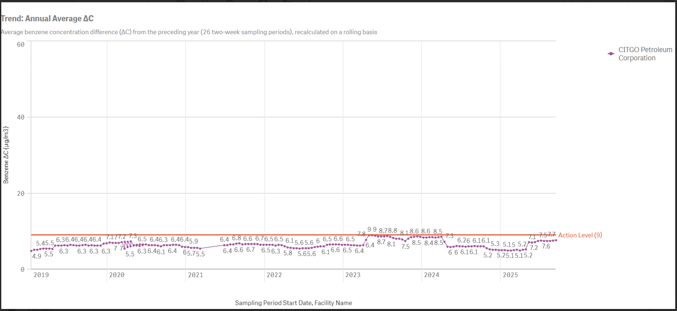
October 4, 2025
Concern:
CITGO Lemont’s benzene level reported in May 2025 was “way above the EPA threshold of 9 µg/m³.”
In fact...
This was on the west side of the refinery. It was a temporary localized event. None of the other sampling locations showed elevated readings, and the public was not at risk.

Slide 4
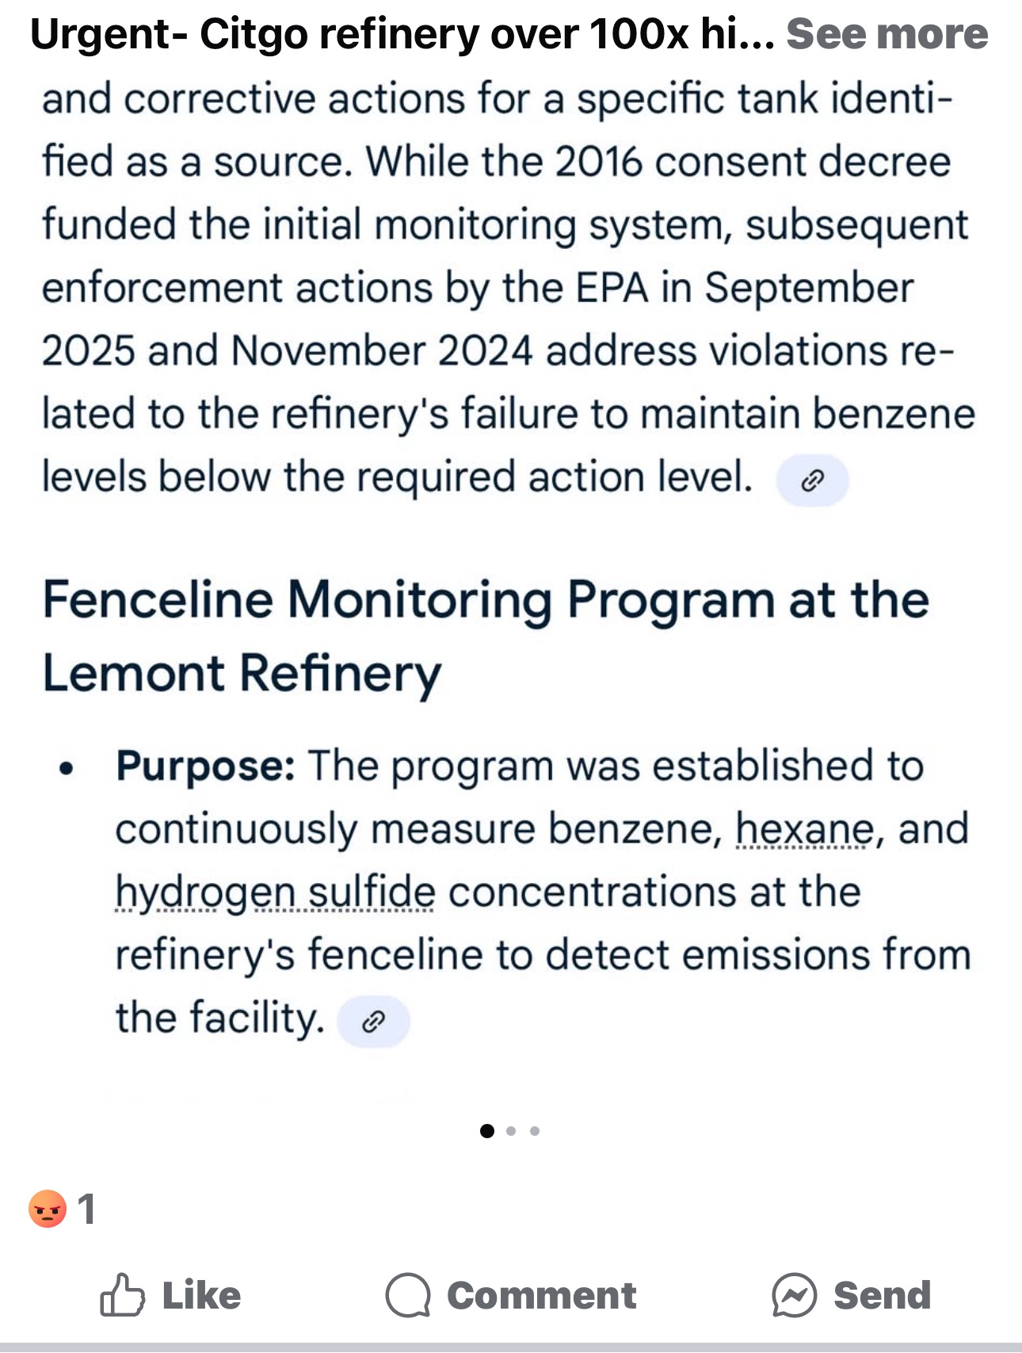
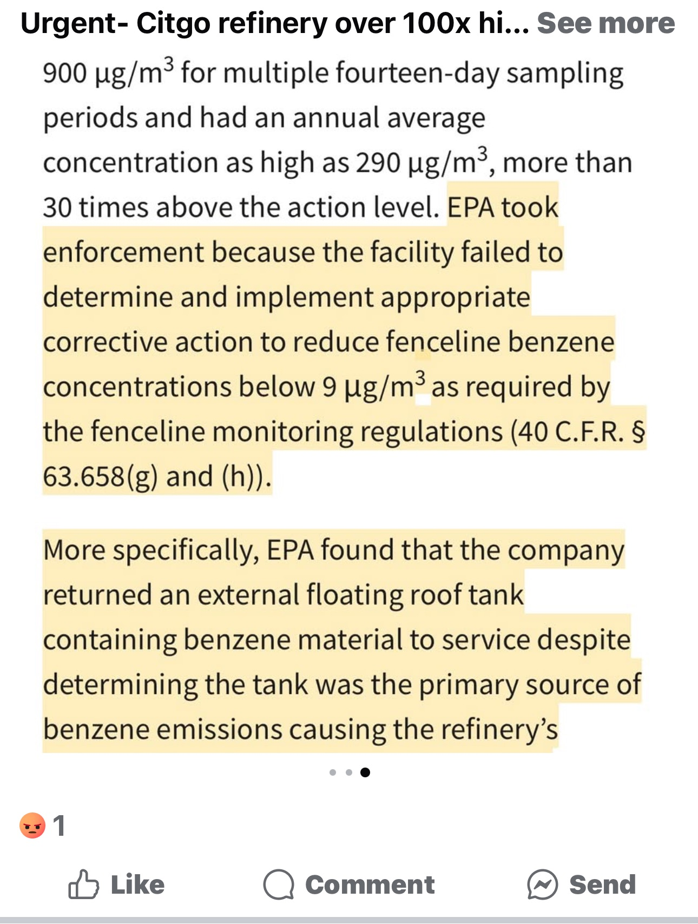
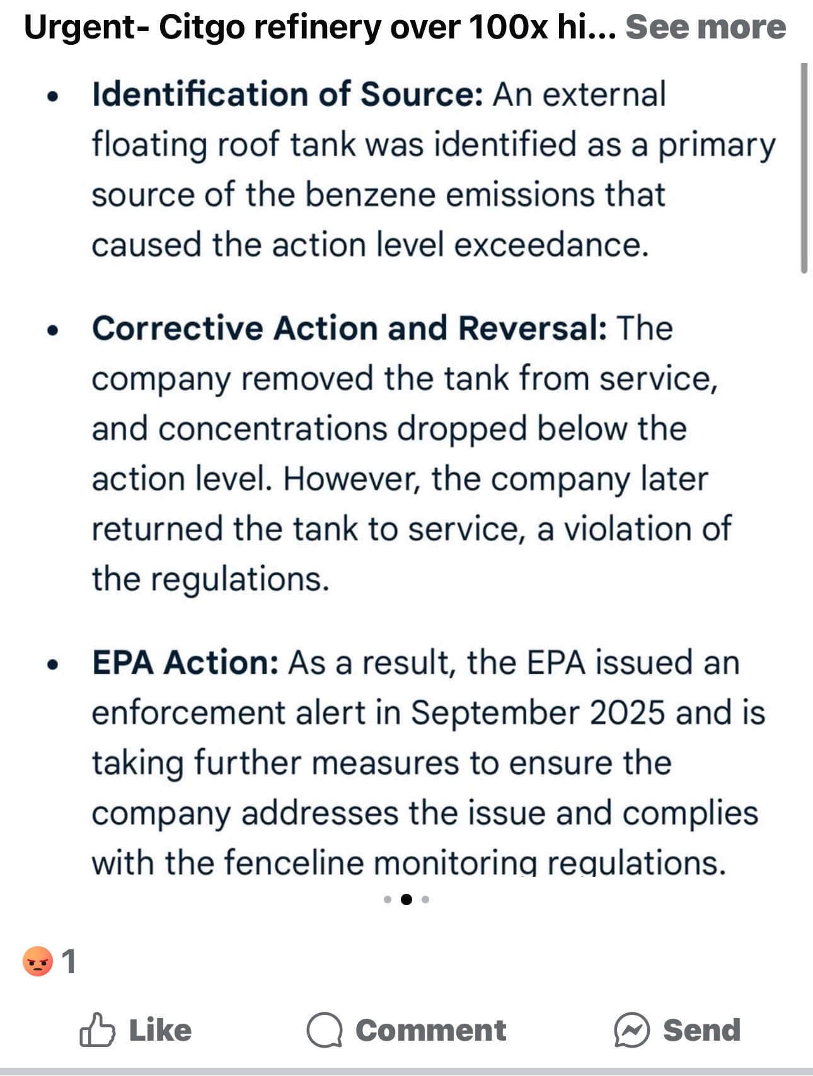
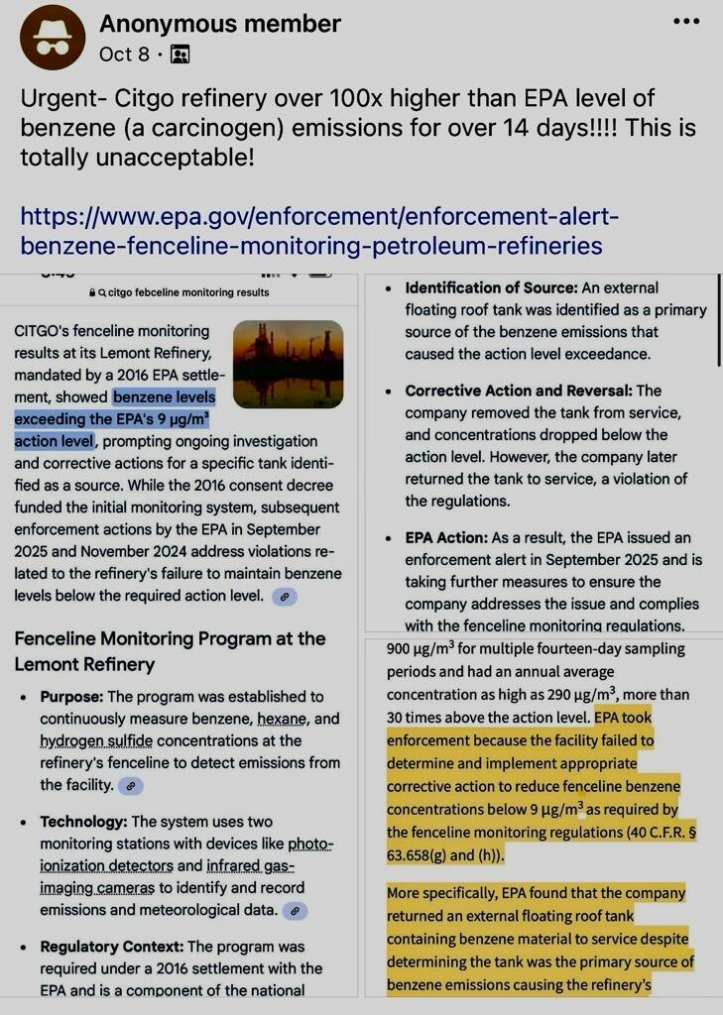
October 8, 2025
Concern:
Public claim that CITGO refinery was 100x higher than USEPA emission limits for benzene.
In fact...
The emissions data (998 µg/m³), the article, and the enforcement action all pertain to a different refinery in New Mexico not CITGO Lemont Refinery.

Slide 5
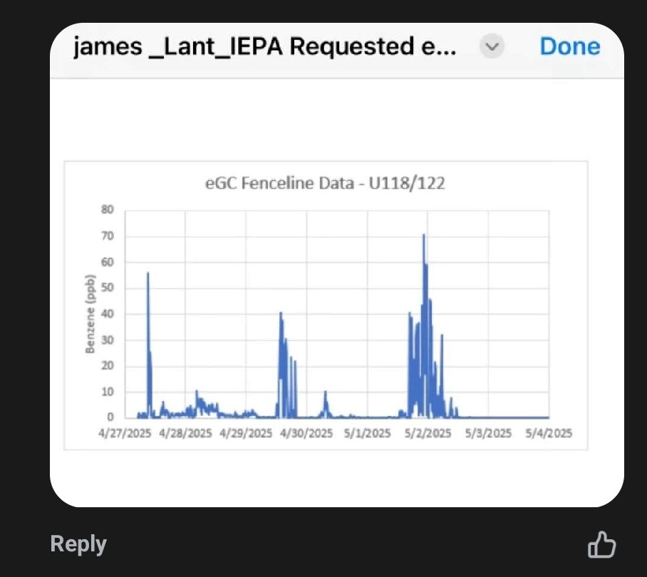
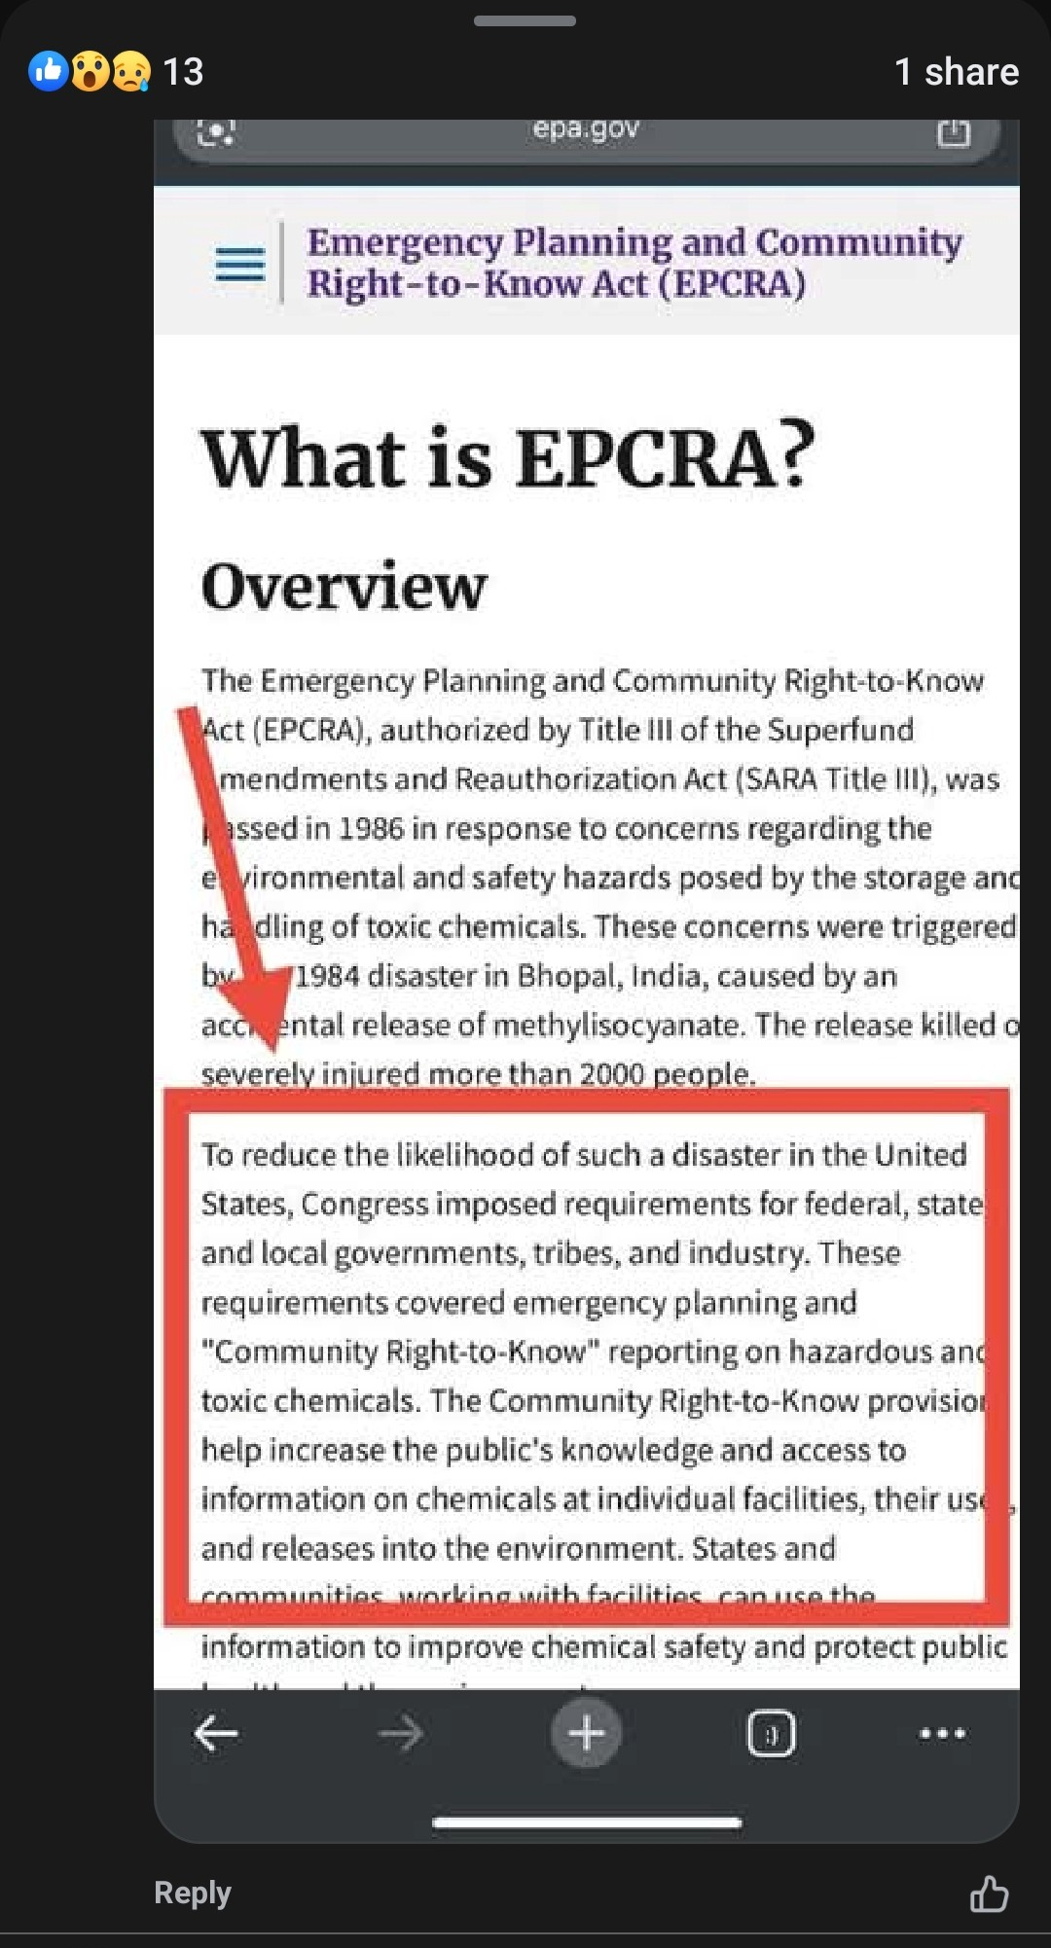
October 20, 2025
Concern:
Fenceline data show excessive emissions.
In fact…
This is not fenceline data. They're measurements from inside the refinery made to proactively identify any potential maintenance issues before there is impact to the local community.
These internal measurements are an enhancement to our fenceline program designed to identify and correct any deficiencies before becoming an issue.

Slide 6
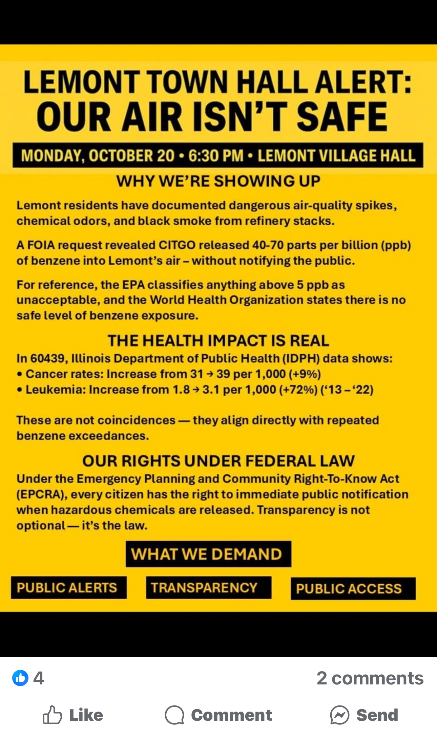
October 20, 2025
Concern:
Lemont residents state that “every citizen has the right to immediate public notification when hazardous chemicals are released,” citing the EPCRA.
In fact…
CITGO complies with EPCRA reporting requirements.
CITGO has agreed to initiate real time monitoring and to work with the Village of Lemont on an improved notification system.
CITGO will continue to engage with the Village of Lemont to ensure community voices are heard and appropriate actions are taken. CITGO is committed to the well-being of Lemont residents.

