Slide 1
Benzene Fenceline Monitoring
Lemont Refinery

Slide 2
General Overview
Sector Rule Requirements for samplers is prescriptive …
Utilizes USEPA Method 325A
Based on size and shape of the facility
2000 linear feet around the perimeter
Additional sampling location required for dock operations
Resulted in 18 locations at the CITGO Lemont Refinery
Program Details
Compliance is based on Highest Measured Concentration – Lowest Measured Concentration (ΔC) for each 2-week sampling period.
Annual average ΔC of the most recent 26 sampling events is the single compliance point for facility
First annual average is calculated after 12 months of sampling
Sampling data is posted online quarterly and accessible to public.

Slide 3
General Overview
Annual average must be less than 9ug/m³ (~2.8 ppb)
If average is above 9ug/m³ a Root Cause Analysis (RCA) is required
RCA must be initiated within 5 days of determining that the action level has been exceeded.
RCA and corrective action must be completed within 45 days of determining that the action level has been exceeded.
A corrective action plan must be submitted to EPA if:
ΔC in the next 14-day sampling period after implementation of corrective action is > 9 µg/m³ (~2.8 ppb), or
If corrective action will take more than 45 days to complete.
Lemont Refinery conducts an investigation whenever a single 2-week sampling period has a result above 9ug/m³

Slide 4
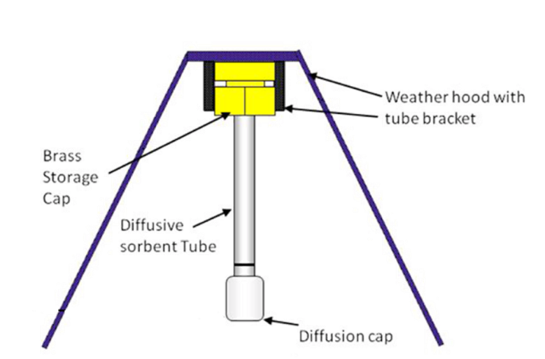
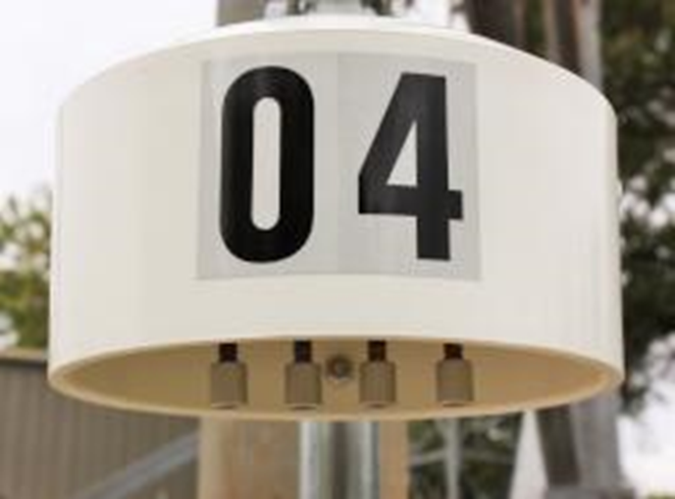
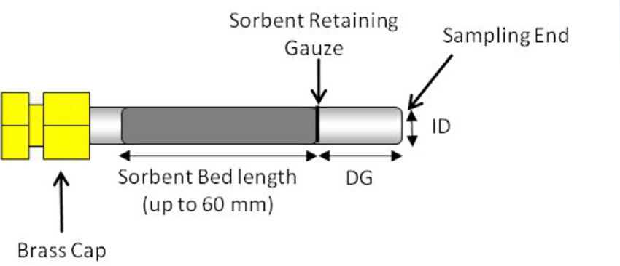
General Overview
Passive sampling using diffusive tube samplers placed under a protective hood along the fenceline.
Sorbent tubes are collected and analyzed by third party lab for benzene every 14 days (13-15 is allowable).

Slide 5
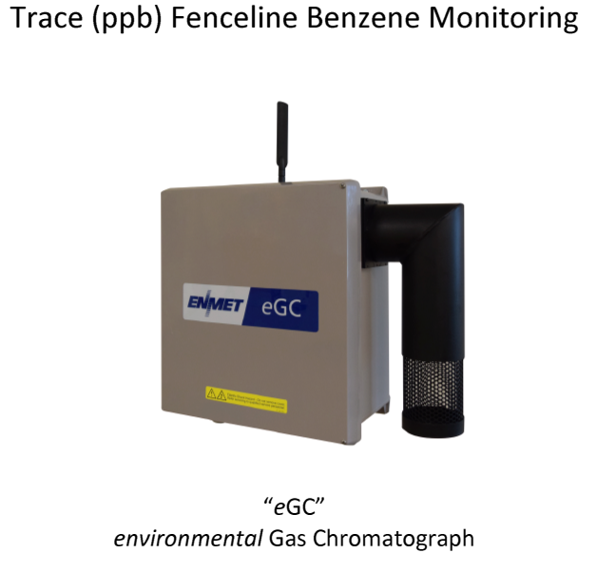
Additional Monitoring
Portable Gas Chromatographs
The refinery operates 2 gas chromatographs inside the refinery
Sample results available every 10 minutes
Used to identify potential issues before there is an impact at the fenceline

Slide 6
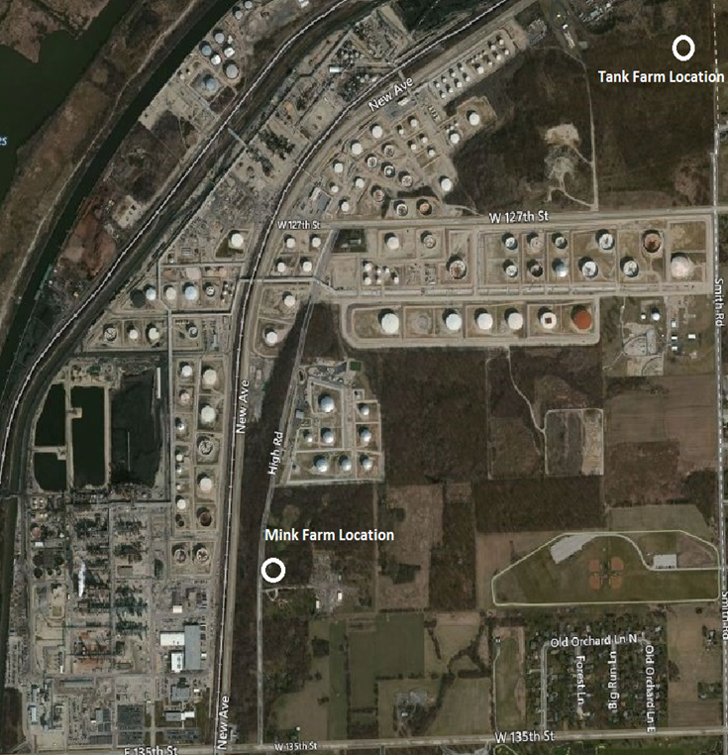
Additional Monitoring
Ambient Air Stations
We have heard the community concerns and have agreed to initiate real-time monitoring in the following locations shown on the map.
Currently working with third party vendor to start real time benzene monitoring.

Slide 7

Questions????

Slide 8
Additional Monitoring
Leak Detection and Repair (LDAR or Fugitive Emissions)
The refinery operates an LDAR program in accordance with Federal regulations
14 Technicians using handheld portable equipment to monitor components throughout the refinery for VOC emissions
Approximately 210,000 individual inspections are completed annually on more than 65,000 components
Any leak detected above the thresholds MUST be repaired within prescribed timelines.
Components are re-monitored to verify effective repairs
Stack Continuous Emission Monitors (CEMS)
Continuous Emissions Monitors on Heaters, Boiler and Wet Gas Scrubber
Real time data on the stacks 24/7
Alarms internally to adjust operation
Data is reported to the State to demonstrate compliance with permit limits

