Slide 1
Risk Assessment for Benzene

Slide 2
What is Risk?
Cause
Effect
What’s the probability that something happens?
Risk

Slide 3
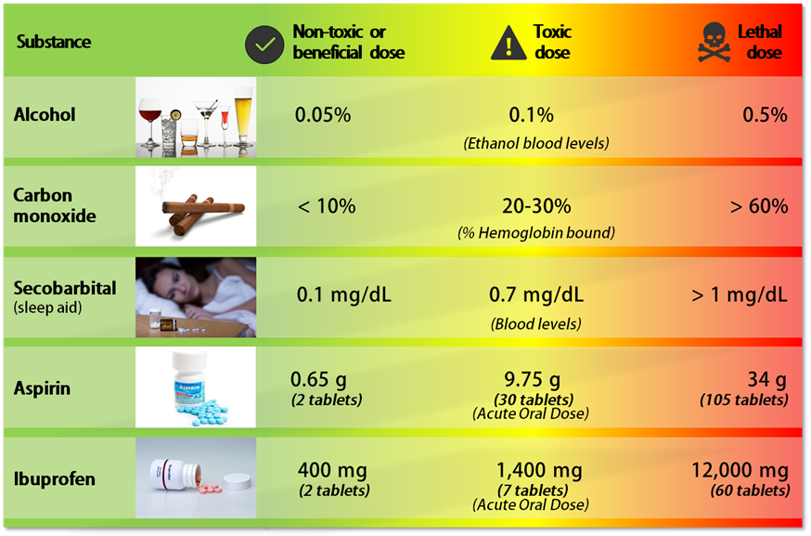
Risk is Inherent to Everyday Life

Slide 4


Quantitative Risk Assessment for Human Health
The characterization of the potential adverse health effects of human exposures to environmental hazards (NRC 1983)
https://www.nationalacademies.org/publications/366
https://www.nationalacademies.org/projects/BEST-K-05-02-A/publication/12209

Slide 5

Quantitative Risk Assessment for Human Health
What’s at issue?
How much is around?
How much increases risk?
What is the probability of disease?
Hazard Identification
Exposure Assessment
Dose-Response
Risk Characterization

Slide 6

Hazard Identification
Review Data
What health effects are associated with the hazard?
Describe Mode of Action
How does the hazard interact with the body?
Evaluate Evidence
How strong is the evidence?
Review Exposure
How does one encounter the hazard?
What’s at issue?
Hazard $≠$ Risk

Slide 7
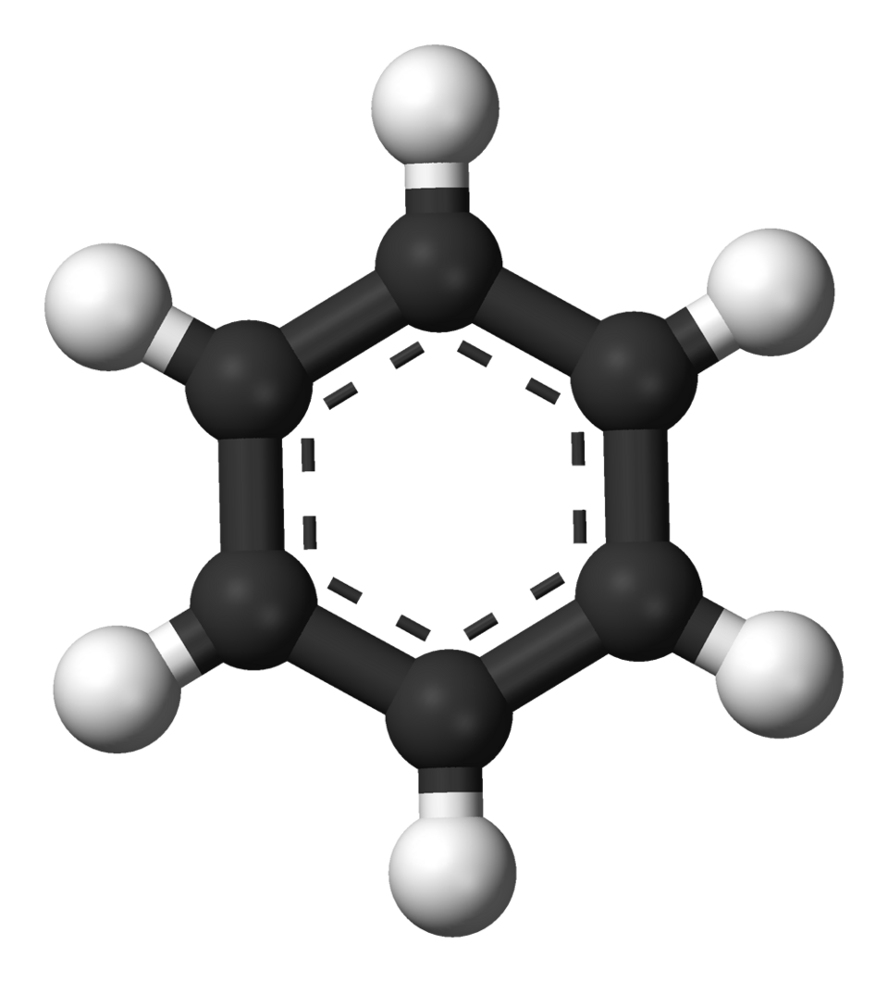
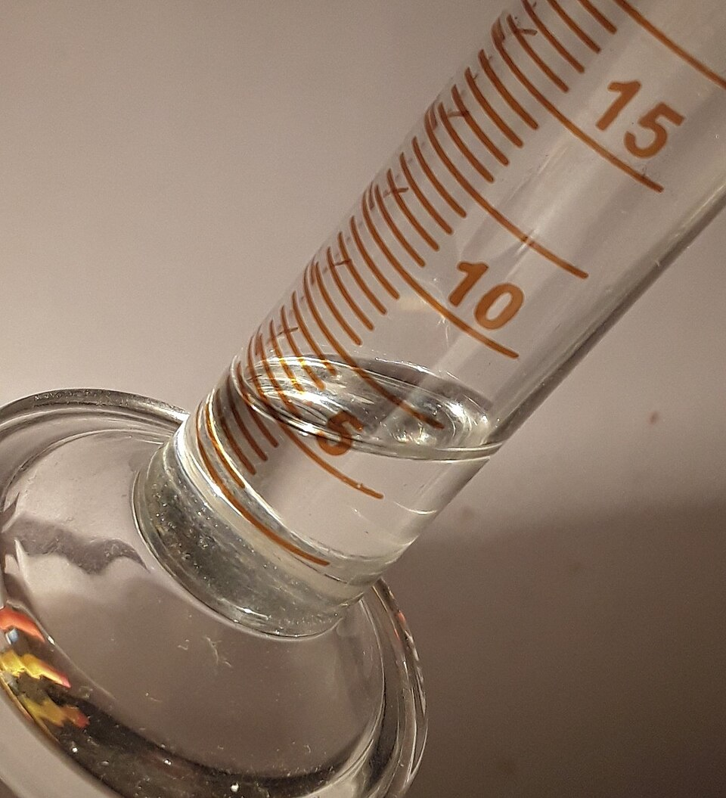
Hazard Identification
Review Data
What health effects are associated with the hazard?
Describe Mode of Action
How does the hazard interact with the body?
Evaluate Evidence
How strong is the evidence?
Review Exposure
How does one encounter the hazard?
Non-Cancer: Decreased White Blood Cells (EPA)
Occupationally
Numerous studies have found that sufficient dose can lead to reduced white blood cell count and an increased risk of AML
Cancer: Leukemia (specifically Acute Myeloid Leukemia (AML)) (EPA)
Inhalation
Environmentally
https://en.wikipedia.org/wiki/Benzene#/media/File:Benzene-aromatic-3D-balls.png
https://en.wikipedia.org/wiki/Benzene#/media/File:Benzene_sample.jpg

Slide 8
Exposure Assessment
Important Details for Assessing Exposure
Type
Chemical composition
Intensity
Intensity (i.e., concentration)
Frequency
How frequently this exposure occurs
Duration
How long it occurs
Route
How far from the emission point to the receptor
How much is around?

Slide 9
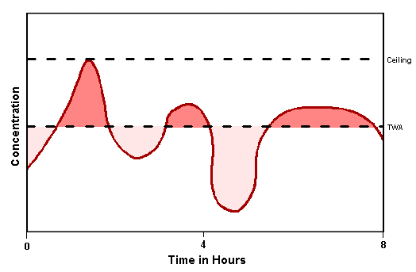
Exposure Assessment
Exposures vary over time
Exposures can be summarized as:
Minimum
Median (50th Percentile)
Arithmetic Mean
Geometric Mean
Maximum
For a risk assessment we are generally concerned with the arithmetic or geometric mean of exposures with an appropriate averaging time

Slide 10

Units of Measurement
Micrograms per cubic meter (µg/m³)
1 µg = 0.000001 g
A single grain of table salt is 60 µg
On average, an adult breaths 16 m³ of air per day
1 m³ = 264 gallons
1 µg/m³ = 1/60 of a grain of salt mixed in 264-gallon containers

Slide 11
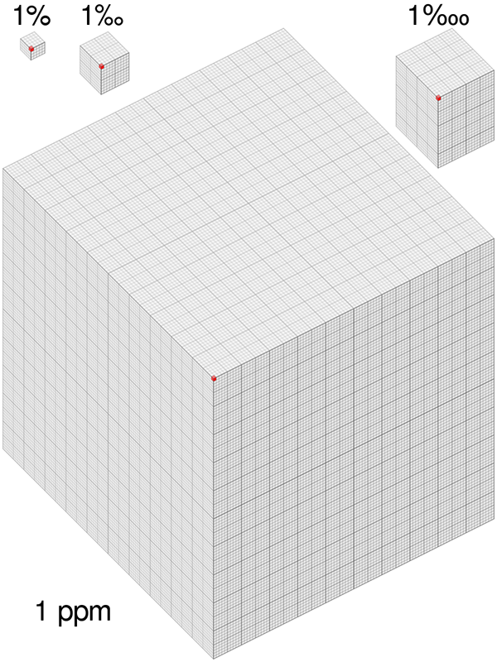
Units of Measurement
Parts per billion (ppb)
Amount of something in something else
1 ppb = 1 second in 32 years
(1 year = 31,540,00 second)
Can convert from µg/m³ to ppb
Parts per million (ppm)
1 ppm = 1000 ppb
1 ppm = 1 second in 11.5 days
Benzene:
1 ppb = 3.19 µg/m³ x 24.45 ÷ 78.11 g/mol
https://www.chemaqua.com/en-us/blog/2019/10/29/what-is-ppm/

Slide 12
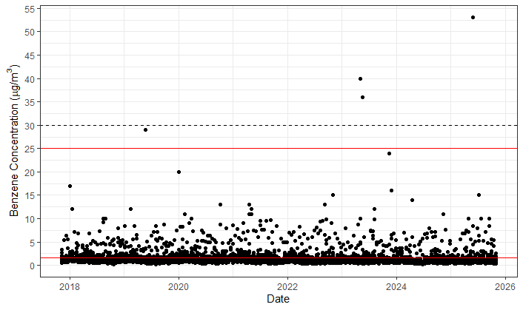
Exposure Assessment – Fenceline Monitoring (Unadjusted)
EPA’s Reference Concentration
99.9% of measurements are below this line
Arithmetic Mean (1.6 µg/m³)
The fenceline concentrations will be higher than concentrations in the nearby community

Slide 13
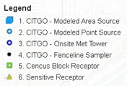
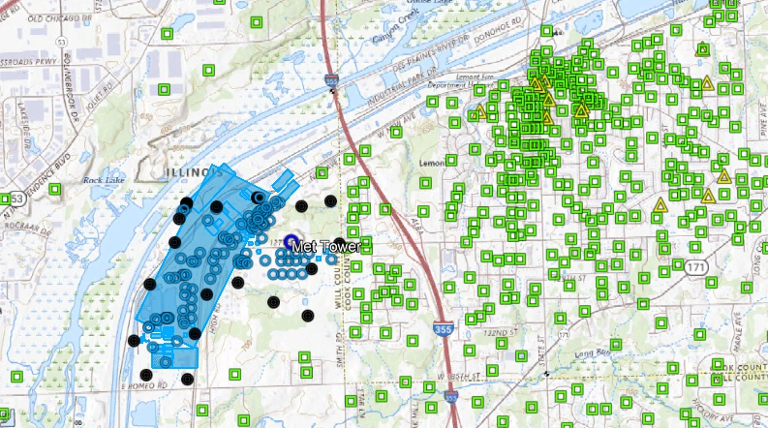
Fenceline Data is Not Representative of Personal Exposure
Fenceline data allows some insights into emissions.
However, because of the distance between these monitors and where people are located, modeling must be used to estimate concentrations of benzene in areas of interest.
Modeling allows for consideration of meteorological effects (primarily wind direction and wind speed).
Where we have data
Where we want estimates
Notes:
Change legend to “Modeled […]

Slide 14
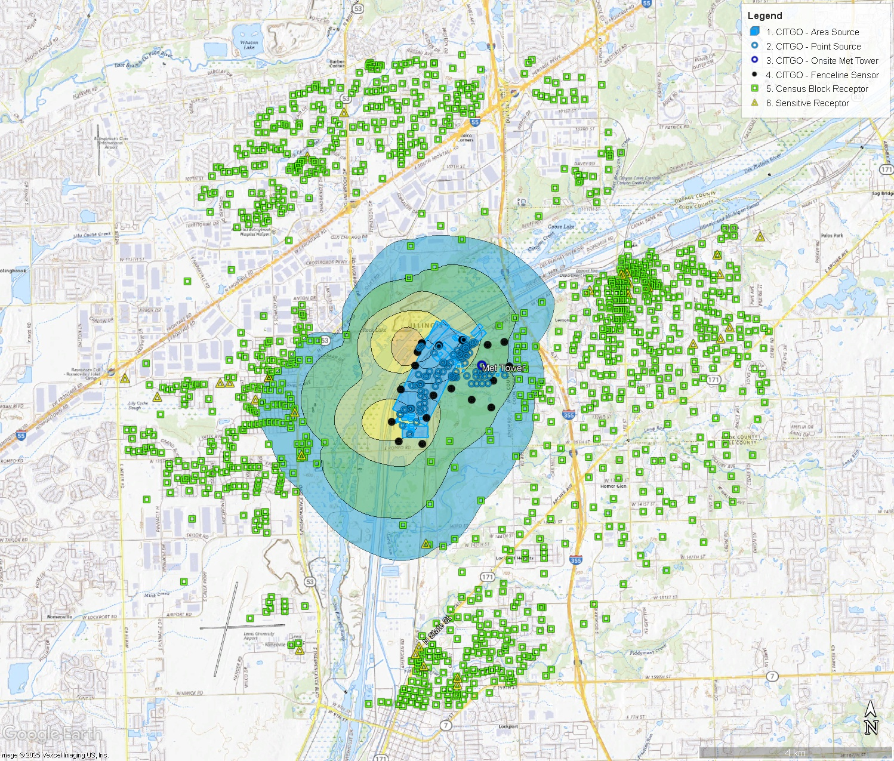
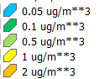
Exposure Assessment – AERMOD Results
Rank | Annual Concentrations
 | Benzene (µg/m³) | UTM East (m) | UTM North (m) | Year
1 | 0.1849 | 412739.75 | 4610192.33 | 2024
2 | 0.1746 | 412739.75 | 4610192.33 | 2023
3 | 0.1744 | 412739.75 | 4610192.33 | 2021
4 | 0.1720 | 412739.75 | 4610192.33 | 2018
5 | 0.1667 | 414174.75 | 4612948.17 | 2020
6 | 0.1660 | 414174.75 | 4612948.17 | 2023
7 | 0.1648 | 412739.75 | 4610192.33 | 2020
8 | 0.1610 | 414174.75 | 4612948.17 | 2021
9 | 0.1584 | 414174.75 | 4612948.17 | 2024
10 | 0.1562 | 414174.75 | 4612948.17 | 2019

Slide 15
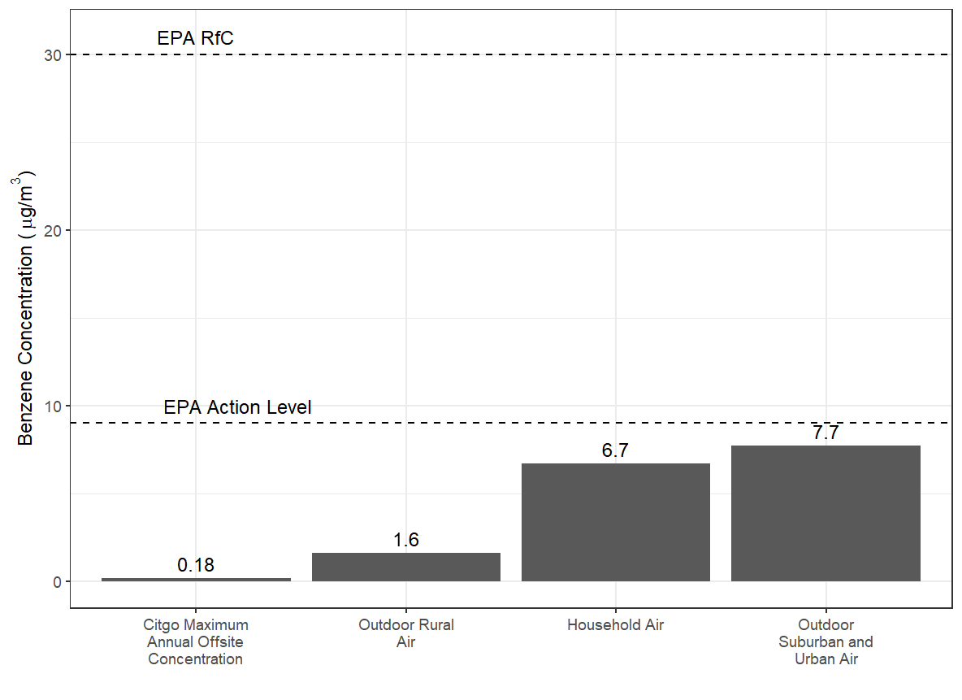
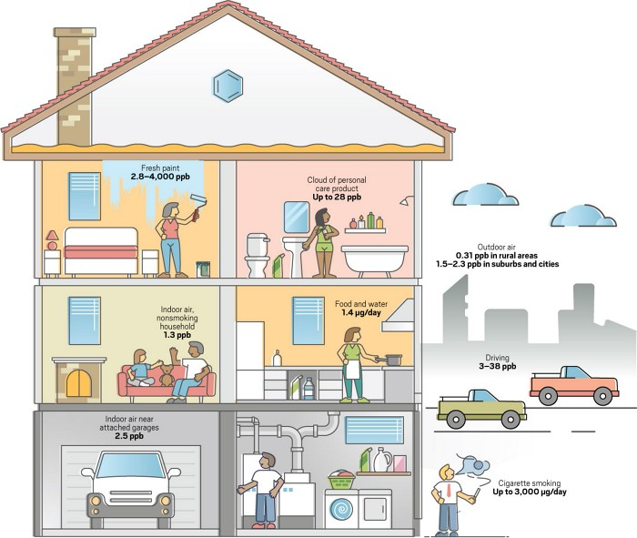
Exposure Assessment – Comparisons
Outdoor Air, Rural: 1.6 µg/m³
Outdoor Air, Suburban and Cities: 7.7 – 10.2 µg/m³
14.3 -20,478.2 µg/m³
143.3 µg/m³
6.7 µg/m³
7.2 µg/m³
12.8 µg/m³
15.4 -194.5 µg/m³
Sources: US Environmental Protection Agency, World Health Organization, Valisure, Int. J. Environ. Res. Public Health 2021, DOI: 10.3390/ijerph18041872. Reproduced from Bettenhausen (2021):
Notes:
Add AL, scale text

Slide 16
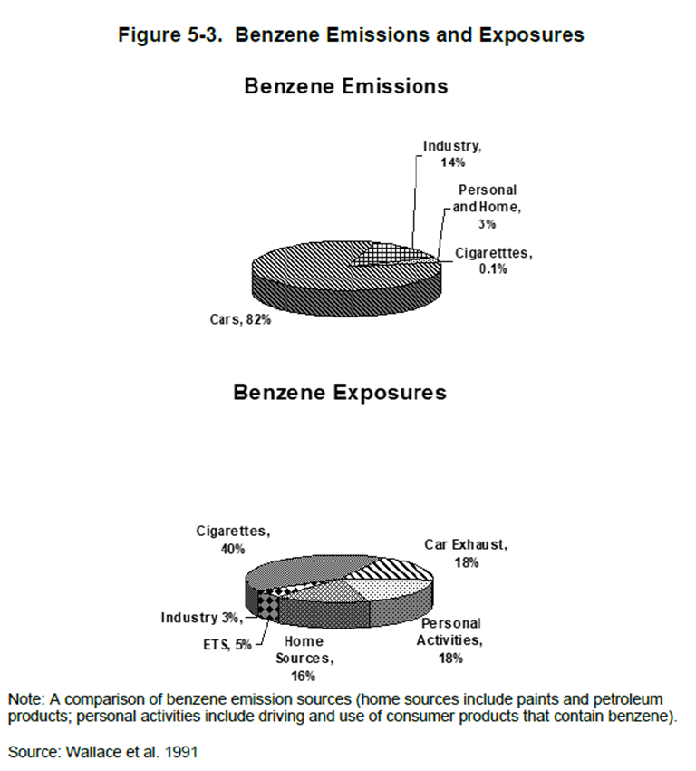
Sources of Benzene
“The most significant general population exposures [to benzene] are in indoor air from sources such as evaporative emissions from cars in attached garages, or from cooking on gas stoves, from smoking, and from automobile related activities such as pumping gasoline.” (CDC ATSDR 2024)

Slide 17
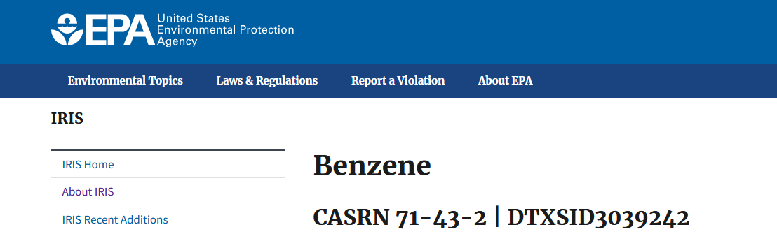
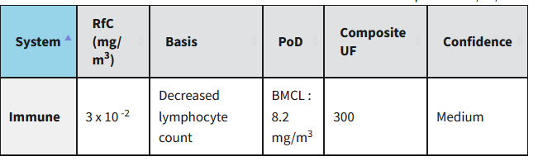
Dose-Response (Non-Cancer)
Reference Concentration (RfC):
“The continuous inhalation exposure that is likely to be without an appreciable risk of health effects during a lifetime” (EPA)
Equivalent to 30 µg/m³
How much increases risk?

Slide 18
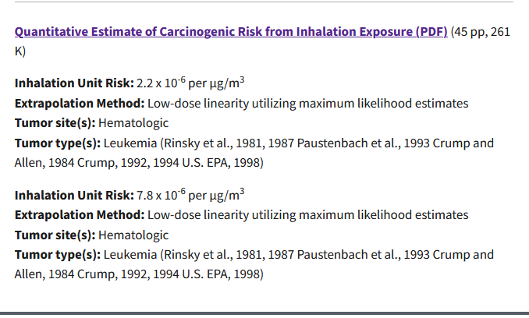
Dose-Response (Cancer)
Inhalation Unit Risk (IUR):
“The increase in lifetime cancer risk from a lifetime (70 years) of exposure” (EPA)

Slide 19
Dose-Response
Endpoint | Exposure Route | Dose-Response Metric | Acceptability Criteria
Non-Cancer: Reduced White Blood Cell Count | Inhalation | Reference Concentration (RfC): 30 µg/m³ | MOS >1
Cancer: Leukemia | Inhalation | Inhalation Unit Risk (IUR) (per µg/m³): LB: 2.2 x 10⁻⁶ UB: 7.8 x 10⁻⁶ | Lifetime Cancer Risk between: 1x10⁻⁴ (1 in 10,000) 1x10⁻⁶ (1 in 1,000,000)
Source: EPA IRIS
https://www.epa.gov/iris/basic-information-about-integrated-risk-information-system
https://www.epa.gov/fera/risk-assessment-other-effects

Slide 20
Risk in Perspective
Lifetime ‘Risk’ | Event
1 in 95 | Dying in a car crash
1 in 2,461 | Dying from choking on food
1 in 10,000 | EPA Upper-End Acceptable Risk
1 in 39,192 | Dying in a severe storm
1 in 44,499 | Dying from a dog bite
1 in 340,733 | Dying from fireworks
1 in 1,000,000 | EPA Lower-End Acceptable Risk
1 in 1,048,576 | Flipping a coin 20 times and getting all heads
https://injuryfacts.nsc.org/all-injuries/preventable-death-overview/odds-of-dying/
https://www.floridamuseum.ufl.edu/shark-attacks/odds/compare-risk/death/

Slide 21
Risk Characterization (Non-Cancer)
Max Annual Offsite Concentration (µg/m³) | EPA Reference Concentration (RfC): | MOS | Conclusion
0.18 | 30 µg/m³ | 30/0.18 = 167 | Acceptable
What is the probability of disease?
Reference Concentration (RfC):
The continuous inhalation exposure that is likely to be without an appreciable risk of health effects during a lifetime (EPA)

Slide 22
Risk Characterization (Cancer)
Max Annual Offsite Concentration (µg/m³) | EPA Reference Inhalation Unit Risk (per µg/m³): | Lifetime Cancer Risk (70 years) | Conclusion
0.18 | LB: 2.2 x 10⁻⁶ UB: 7.8 x 10⁻⁶ | LB: 4 x 10⁻⁷ (4 in 10,000,000) UB: 1 x 10⁻⁶ (1 in 1,000,000) | LB: Acceptable UB: Acceptable
Inhalation Unit Risk (IUR):
The excess lifetime cancer risk from a lifetime of exposure (EPA)
EPA aims for a lifetime cancer risk between:
1x10⁻⁴ (1 in 10,000) to 1x10⁻⁶ (1 in 1,000,000)

Slide 23
Conclusions
Risk is inherent to everyday life
Quantitative risk assessment is a formalized method for estimating risk
Hazard Identification
Exposure Assessment
Dose-Response Analysis
Risk Characterization
The average fenceline concentration was 1.6 µg/m³
The maximum annual offsite concentration was 0.18 µg/m³
These values are consistent with ambient and indoor concentrations of benzene
The risks of adverse health effects in the community were considered de minimis and within the range considered acceptable by EPA.

